Slide 1
Linear and Binary Search(Python)
Presentation by:- Shreejan Maharjan
Batch:- 32 ‘A’ (Computing)

Slide 2
What is a search algorithm?
The algorithm which is used to check or retrieve data from any type of data structure is known as a searching algorithm. The method for searching a data in the data structure it is stored in varies by two types; Binary search and Linear search.

Slide 3
What is Linear search?
The type of search algorithm which sequentially searches through the data structure for the given element/data is known as linear search. It searches the data through the data structure which causes it to be less efficient than binary search.

Slide 4
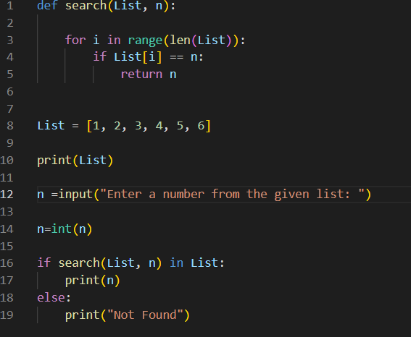
Example of linear search

Slide 5
Output

Slide 6
What is Binary Search?
The search algorithm which is used to retrieve or check a data from sorted data is known as binary search. It is more efficient than linear search as it usually targets the center of the structure which reduces the spaces it has to search through.

Slide 7
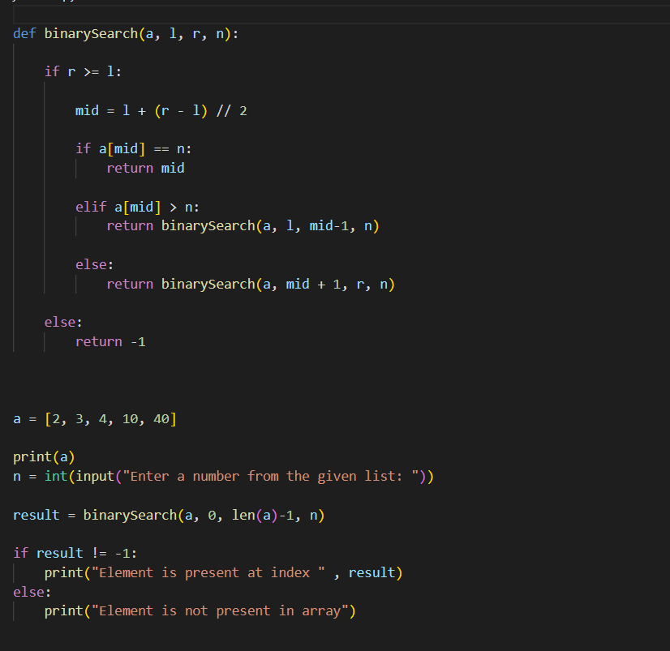
Example of binary search

Slide 8
output

